Slide 1
CS 3331 Space Debris in LEO
Team Members:
Caitlin Gregory
Daniela Gutierrez

Slide 2
Diagrams

Slide 3
UML Use Case Diagram

Slide 4
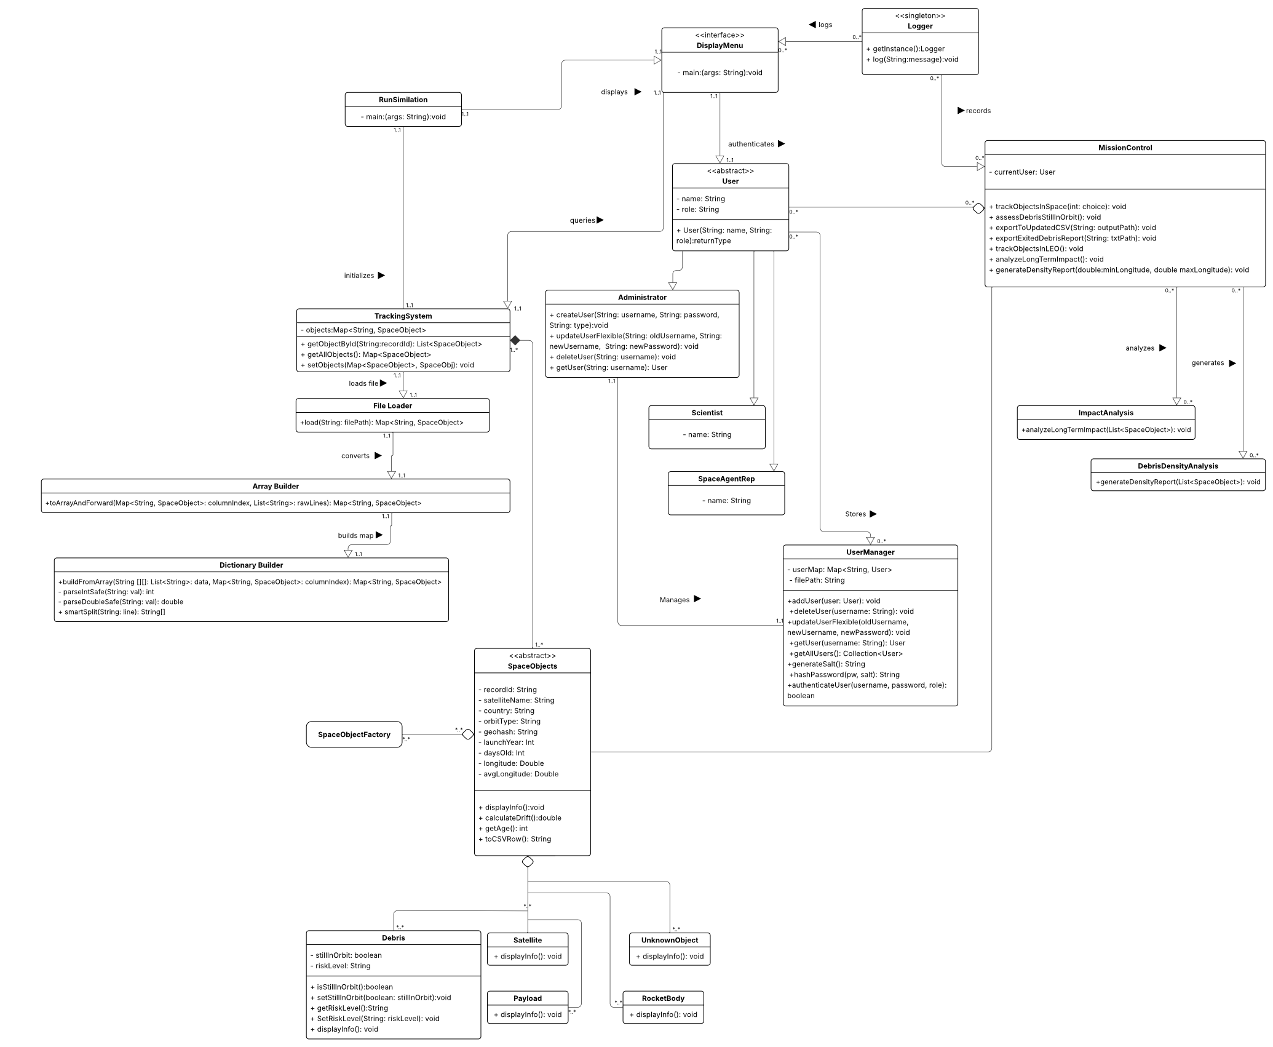
UML Class Diagram

Slide 5
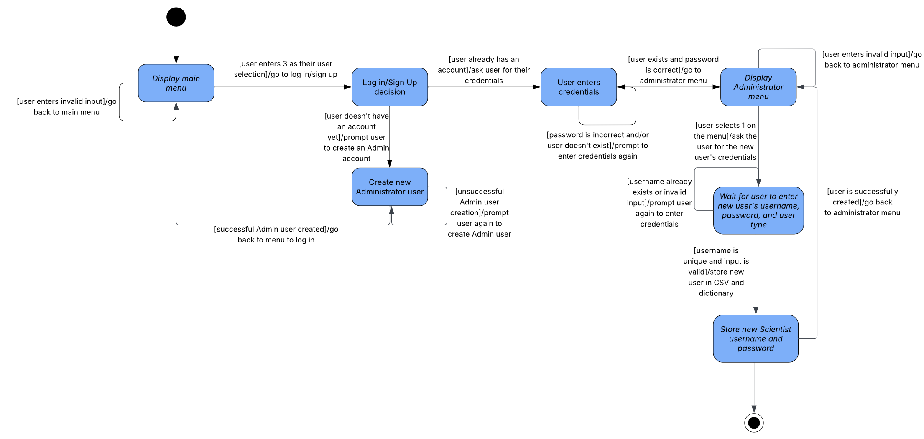
UML State Diagram Add New Scientist User

Slide 6
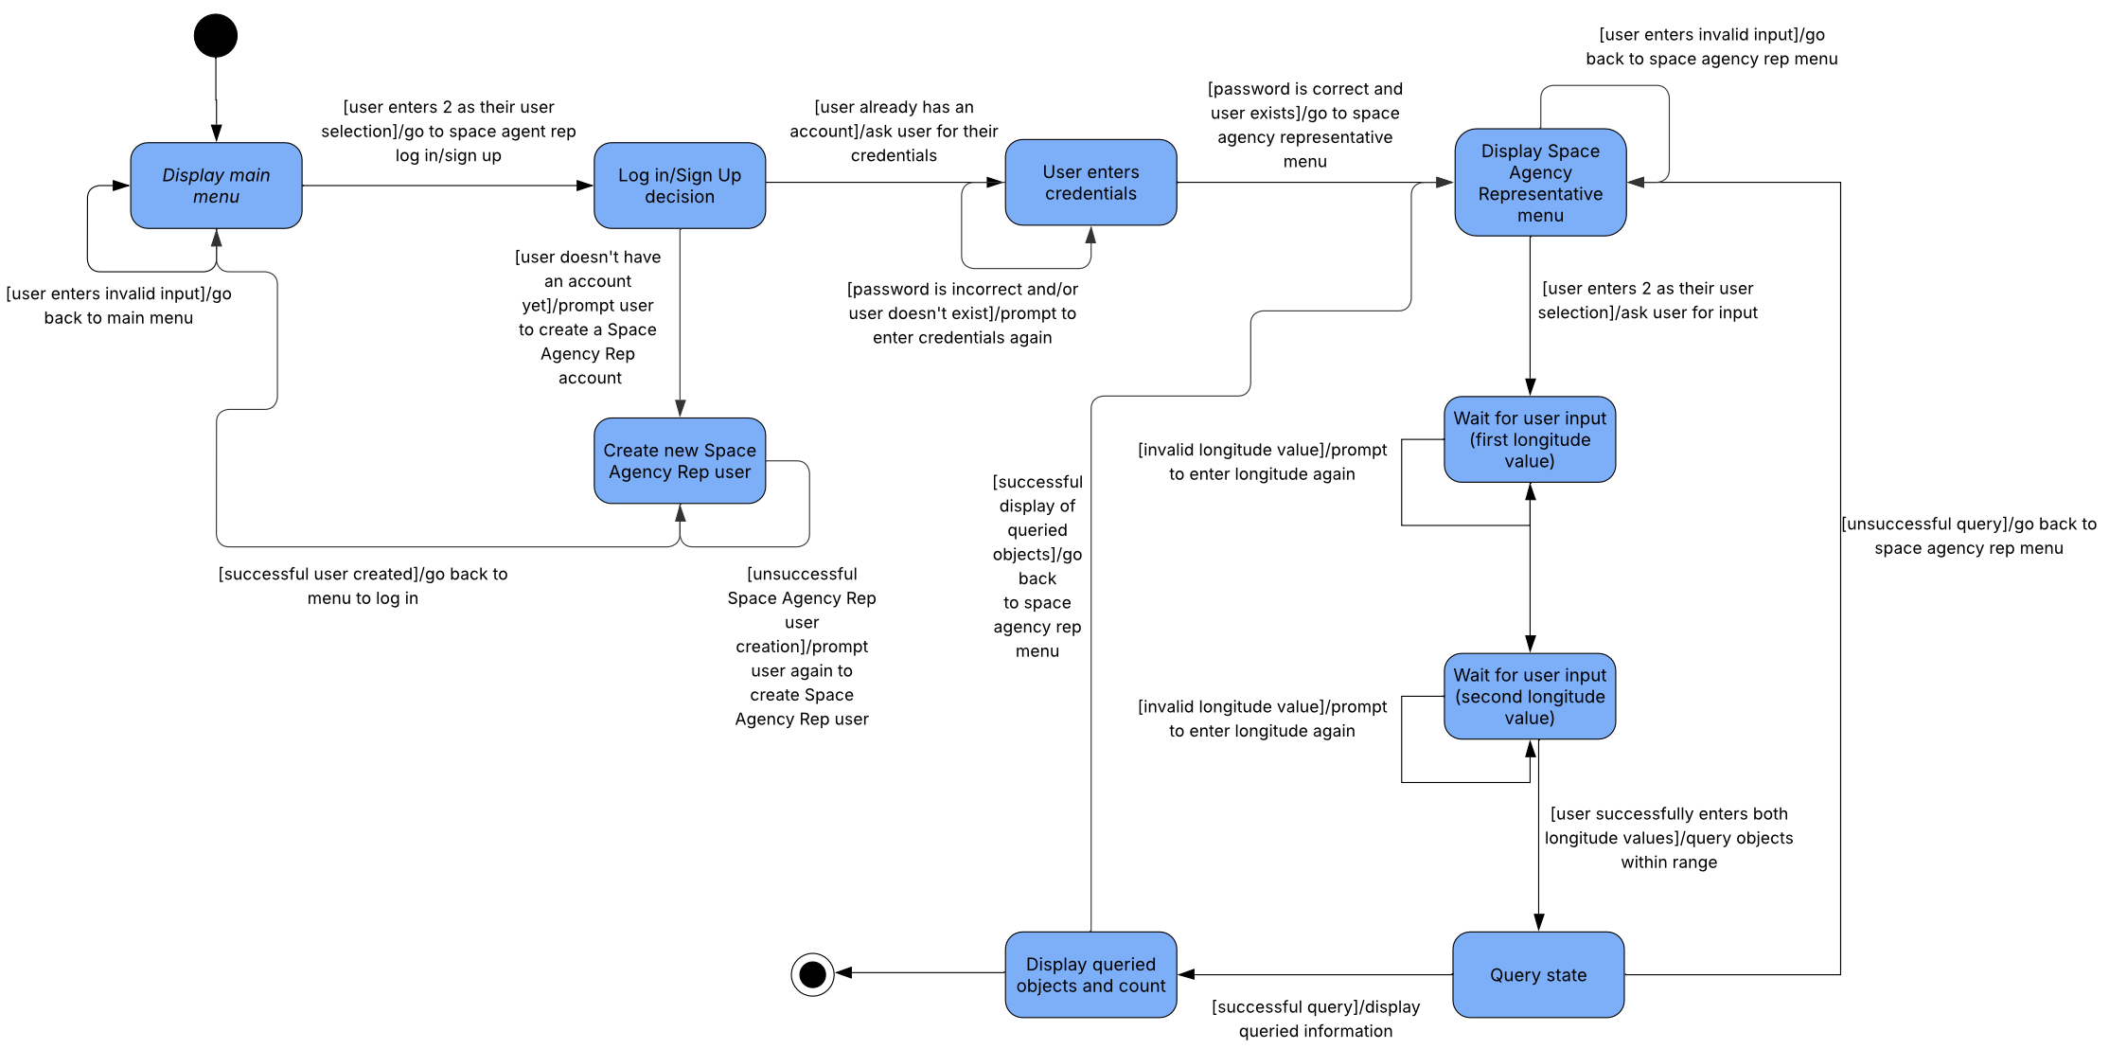
UML State Diagram Generate Density Reports

Slide 7
How did we use Object-Oriented Programming?
Our project uses object-oriented programming principles extensively to promote modularity, reusability, and scalability:
Abstraction: High-level classes like MissionControl, DisplayMenu, and UserManager encapsulate complex functionality behind simple interfaces.
Encapsulation: Data and behavior are tightly coupled in classes such as Debris, RocketBody, and User, ensuring safe access through methods like setRiskLevel() or authenticateUser().
Polymorphism: Methods like displayMenu() and trackObjectsInSpace() operate on base types (User, SpaceObject) but invoke subclass-specific behavior seamlessly (e.g., Debris vs Payload).
Inheritance: User is a base class extended by Scientist, Administrator, and SpaceAgentRep, allowing role-specific behavior while sharing common logic.

Slide 8
How did we use Design Patterns?
We implemented the Singleton Design Pattern in our Logger class.
In a system with multiple menus and user interactions, consistent and centralized logging is essential. We wanted to:
Avoid creating multiple logger instances.
Ensure all logs write to the same place (logger.txt file).
Promote memory efficiency and prevent redundancy.
The Logger class has a private static instance and a private constructor, preventing external instantiation.
It exposes a getInstance() method to provide global access to the one and only logger.
The components (like DisplayMenu, MissionControl, and user classes) call Logger.getInstance().log(...) to log activity in a consistent way, passing in a String with the desired message to log.

Slide 9
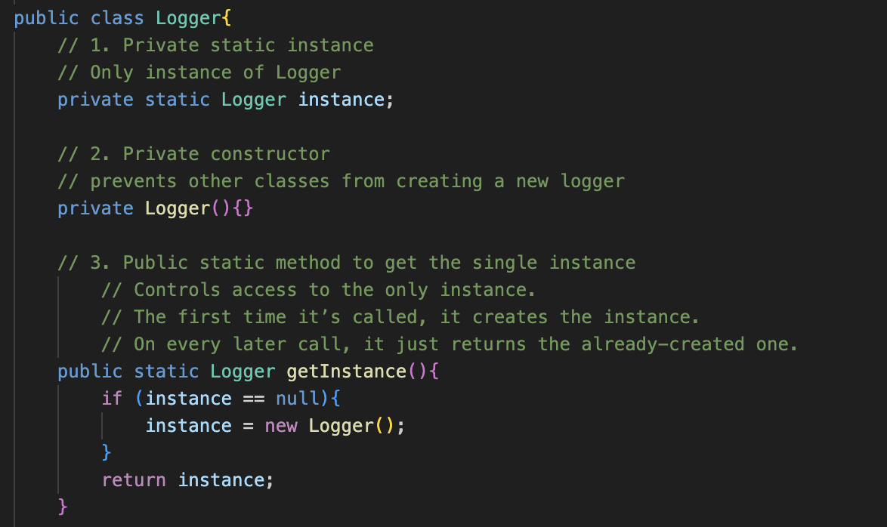
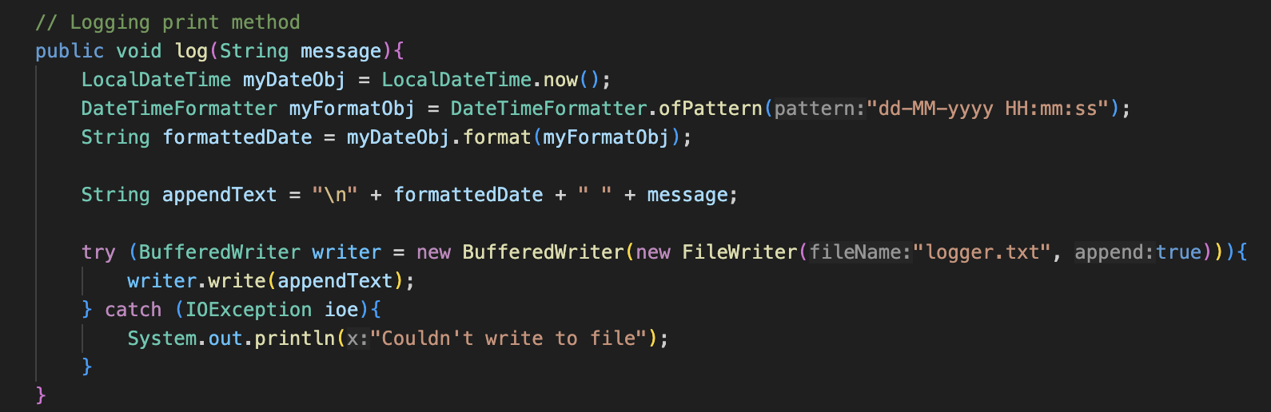

Slide 10
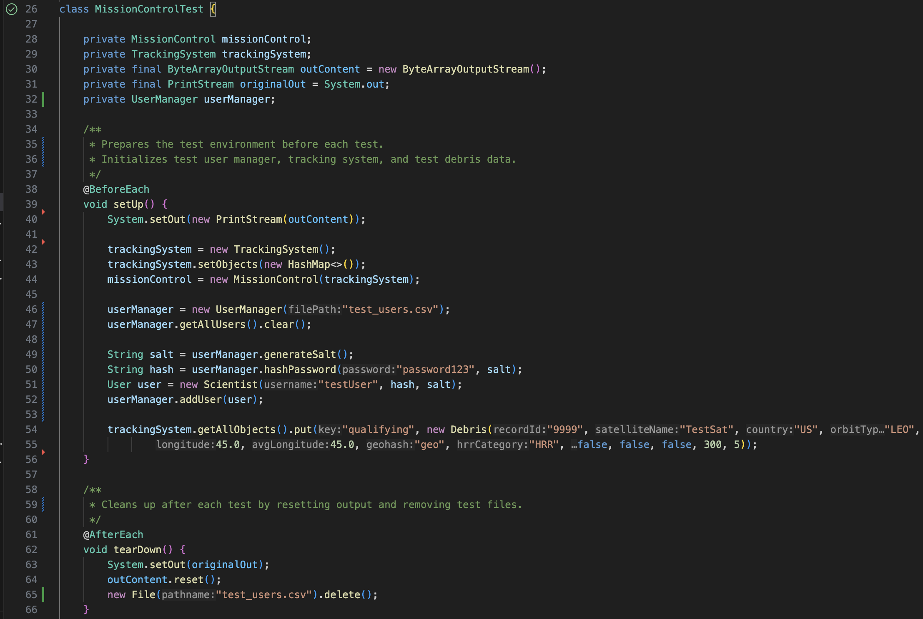
JUnit
To produce test cases for the JUnit, we thought about all (or at least most) of the possible input scenarios for the specific code section that we were testing, and we used assertions to determine whether the code was returning the expected results.

Slide 11
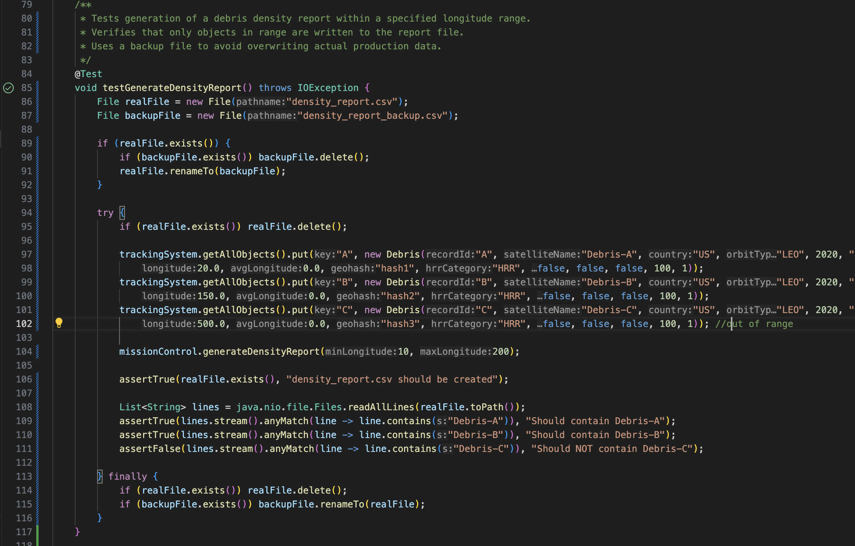
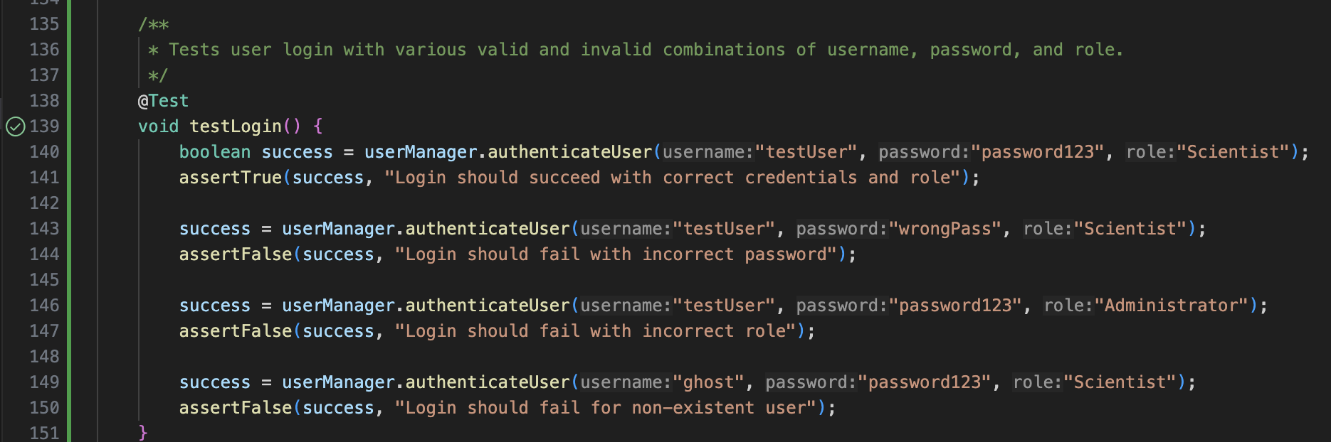
JUnit

Slide 12
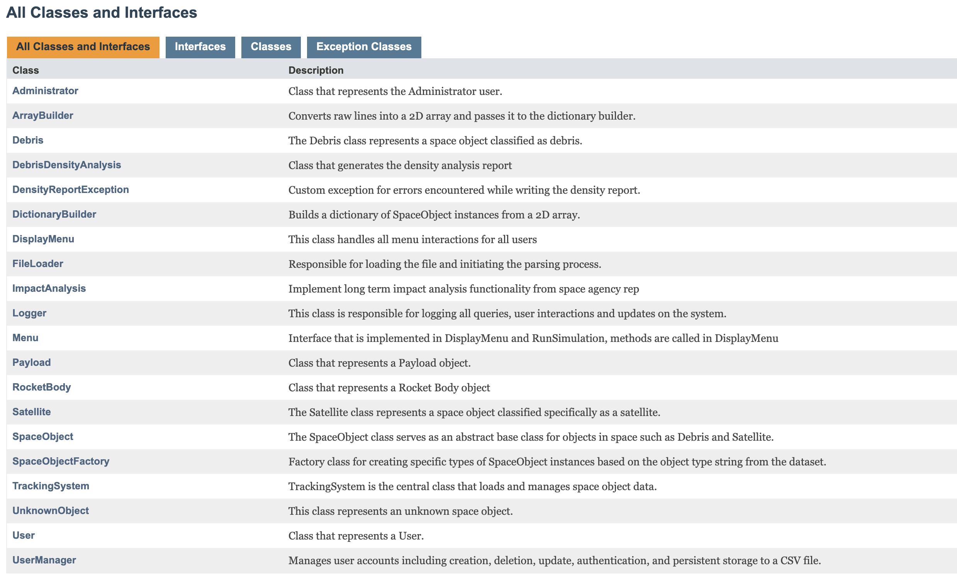
Javadoc
The Javadocs provide us with useful documentation about the functionality, classes, variables, and overall functionality of our code; they are generated after writing comments in a specific format.

Slide 13
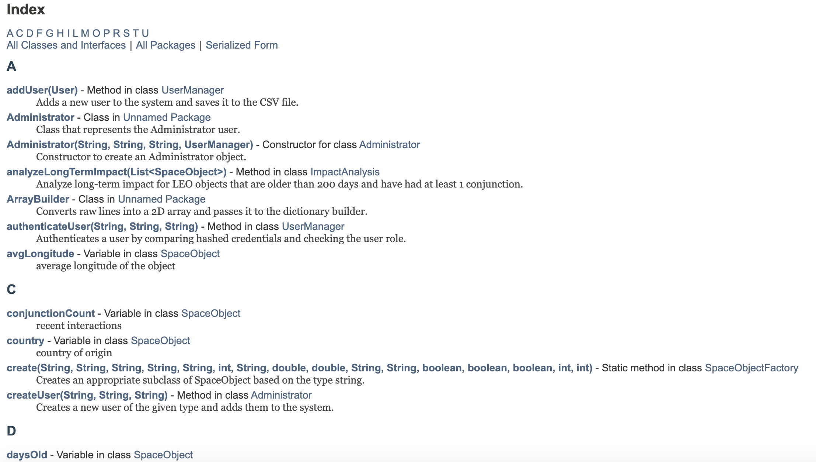

Slide 14
Reflections

Slide 15
This assignment helped us strengthen our ability using different classes and objects, and how they relate to each other.
We learned a lot about important Object-Oriented Programming principles such as inheritance, polymorphism, and encapsulation.
We broke this problem into smaller parts by thinking about the concepts in a high-level manner and then going deeper into the specifics of the implementation.
We think that this course allowed us to delve deeper into a topic that we first discussed in CS1, and to truly understand how the interactions between objects can compose a complex system.
One of the issues that we faced was understanding the way the diagrams were supposed to be composed, specially for the state diagram. The file reading was also difficult at times.
We were able to overcome the challenges presented by asking the instructional team for help and clarification, or by browsing through the Internet to try to find a possible solution.

Slide 16
References

Slide 17
https://www.geeksforgeeks.org/sha-256-hash-in-java/ -> for the hashing of the passwords
https://beginnersbook.com/2014/01/how-to-append-to-a-file-in-java/ for writing into an existing file

Slide 18
Thank you!

